Slide 1
Unsupervised Curricula for Visual Meta-Reinforcement Learning
Allan Jabri, Kyle Hsu, Ben Eysenbach, Abhishek Gupta, Sergey Levine, Chelsea Finn
NeurIPS 2019

Slide 2
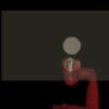
Unsupervised Sensorimotor Learning
Goal: Prepare an agent to efficiently learn downstream tasks by pre-training in an environment, without handcrafted task supervision.
Learn skills that support generalization
Learn skills that can be transferred
Notes:
Most of life is independent study

Slide 3
Unsupervised Skill Acquisition
Prepare an agent to more efficiently learn future tasks by pre-training in an environment, without supervision.
Independent Study
Skill: behaviour that can be operationalized to solve a task
I.e. minimize cost / maximize reward in some environment, reach some goal
Adaptive task distribution: expand frontier of behavior in a way driven by model of current behavior
Continually accumulate skills
Notes:
Most of life is independent study

Slide 4
Transfer and Generalization
Specialists are brittle
Multi-task Policy Learning
Contextual Policies
Condition policy on context information, i.e. a goal or skill representation
Meta-learning
Maximize cumulative reward across some task distribution (i.e. a family of MDPs)
Condition policy on learned encoding of supervised task experience
Learn to explore for task inference and invoke appropriate skill for task execution

Slide 5
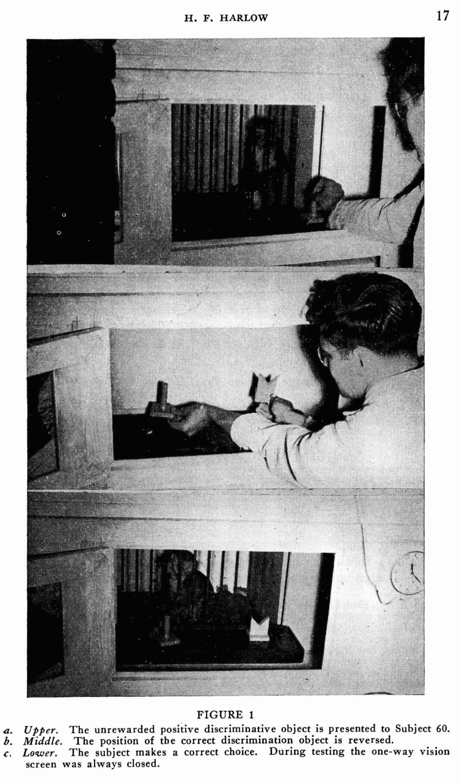
Harlow’s Monkey Experiments
The formation of learning sets. 1949

Slide 6
Unsupervised Meta-learning
Task distributions can be tedious to specify
Unsupervised: Can an agent automatically set its own tasks?
Automatic Curriculum: Task distribution adapts with learner
Notes:
Curricula outside of ML
Teachers
An athlete training
Self-improvement
Curricula in
Tasks: Hand crafted = supervised learning
Curriculum learning: Learning harder tasks: Elman 1990
Meta-learning and apes
2. When we “train”, we are constantly exploring to figure out ways of improving, relative to current behavior

Slide 7
Piaget & Vygotsky
Constructivism
Zone of Proximal Development
зона ближайшего развития

Slide 8
Constructivism
Cognitive development as progressive reorganization of mental processes as a result of biological maturation and environmental experience.
Infants as autonomous, experiential learners.
I <3
DATA

Slide 9
Four Stages of Development, Stage 1: Sensorimotor Development
I. Simple reflexes: birth – 1 mo. Infants use reflexes such as rooting and sucking.
II. First habits and primary circular reactions: 1 – 4 mo. Learn to coordinate sensation with habits and reactions. Primary circular reaction: try to reproduce an event that happened by accident (ex.: sucking thumb).
I <3
DATA

Slide 10
Four Stages of Development, Stage 1: Sensorimotor Development
III. Secondary circular reactions: 4 – 8 mo. Aware of things beyond their own body; they are more object-oriented. Might accidentally shake a rattle and continue to do it for sake of satisfaction.
IV. Coordination of secondary circular reactions: 8 – 12 mo. Can do things intentionally. Recombine schemata and try to reach a goal (ex.: use a stick to reach something). Early object permanence.
V. Tertiary circular reactions, novelty, and curiosity: 12 – 18 mo.
I <3
DATA

Slide 11
Zone of Proximal Development
The “More Knowledgeable Other”: A teacher that nudges the learner towards abilities it could not acquire alone

Slide 12
Sensorimotor Learning
In the current paradigm, learning to act in a visual environment requires expert data or handcrafted rewards
If we want agents that can generalize robustly, this will not scale
Can we learn something useful in an environment without a handcrafted curriculum?
Curriculum driven by current ability
Build on scaffold of current behavior
Notes:
Not only because we would have to label to much
Sometimes we don’t know how to label:
Sparse reward problem, or much more common: REWARD MISPECIFICATION
Becoming a fighter pilot is not just about
How to do this without hand crafted curricula?
Tabula rasa vs digging sand
Perverse obsession with unsupervised learning -> tabula rasa

Slide 13
Unsupervised Skill Acquisition
Learn to efficiently adapt to tasks, while adapting the task distribution to evolve with current ability
Scaffold task distribution with what you currently know
–> Organize, Practice, Explore
Notes:
Also incorporating exploration so that the task distribution shifts as we become competent

Slide 14
Learning something “useful”
Unsupervised: We are being obnoxious in not making many assumptions about the downstream task distribution
No Free Lunch! What can we learn?
Is experience in an environment naturally organizable or compressable?
Appetizer?
Invariance and “Stable Properties” (per Leon Bottou)
Which aspects of the environment matter?
Ex: Proprioception
Inductive biases
Simplifying assumptions about trajectories
ConvNets + Pixels
Notes:
Random behavior will give us some information; can we bootstrap from random behavior to get more structure behavior that can lead us to learn about the environment?

Slide 15
Formulation
Automatic construction of task distribution for Meta-RL
Represent tasks as reward functions
Learn to efficiently adapt to self-constructed tasks, while adapting the task distribution to evolve with current ability
Visual Observations
Learn to associate Stimulus with Reward

Slide 16
Organize
+
+
+
Practice

Slide 17
Organize <-> Practice
Organization: Model current behavior
Compress current behavior into shorter description – “skills”
Ex: Fit density model of behavior
Practice: Acquire Skills
Learn tasks derived from model of current behavior
Ex: Learn reward functions derived from the density model
Exploration: Expand frontier of behavior
Novelty w.r.t current model
Notes:
Exploration will be reflect in the data distribution used to organize next set of skills
Accumulate tasks

Slide 18
Contributions
Method for producing task distribution, scaling to visual environments
Discriminative Clustering
Effective meta-learning of unsupervised task distribution
Positive transfer to downstream test tasks and accelerated learning on target task distributions

Slide 19
An Automatic Curriculum
Repeat
Organize Behavior
Babble current behavior
Update density model of behavior
Practice [+ Explore]
Learn updated task distribution
Explore based on density model

Slide 20
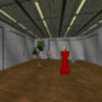
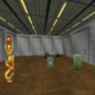
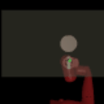
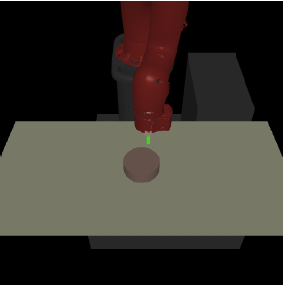
Settings
Visual Navigation in VizDoom
MuJoCo Sawyer w. position control

Slide 21
Organize
Organization as Information-Maximization
Noisy Channel
Trajectory of states
Z

Slide 22
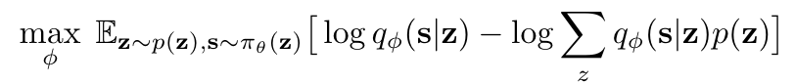
Organize
Organization as Information-Maximization
Fit a deep mixture model to trajectories of current behavior
EM for jointly learning visual representation and trajectory-level clustering
Assume states to be conditionally independent given skill (why?)

Slide 23
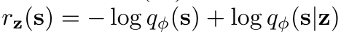
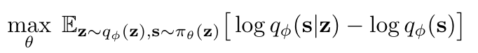
Practice
Construct reward functions from our mixture model
Train policy on task distribution
Notes:
Train our policy to reproduce behavior that we’ve seen in the past
From transient behavior to operationalizable skills

Slide 24
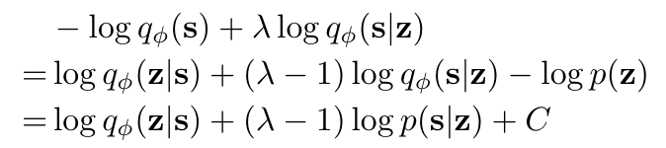
Explore
+
+
Since we have density, we can augment reward function with exploration bonus
+

Slide 25
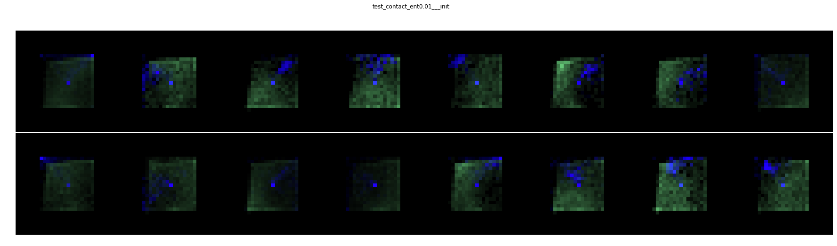
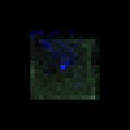
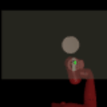


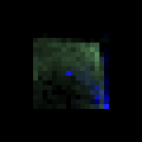
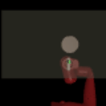
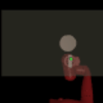
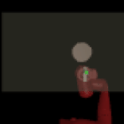
Cluster 12
Cluster 3

Slide 26
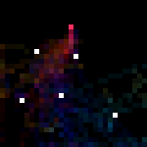
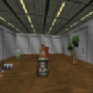
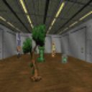
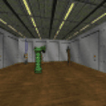
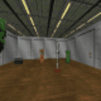
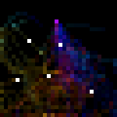
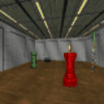
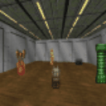
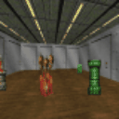
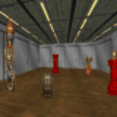

Slide 27
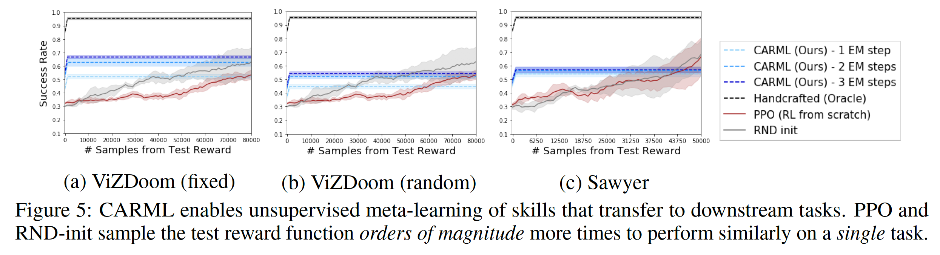
Transfer to Test Task distributions
Apply policy on test object-direct navigation tasks.
Given an environment, randomly sample an object as goal.
Reward function is inverse distance to object.

Slide 28
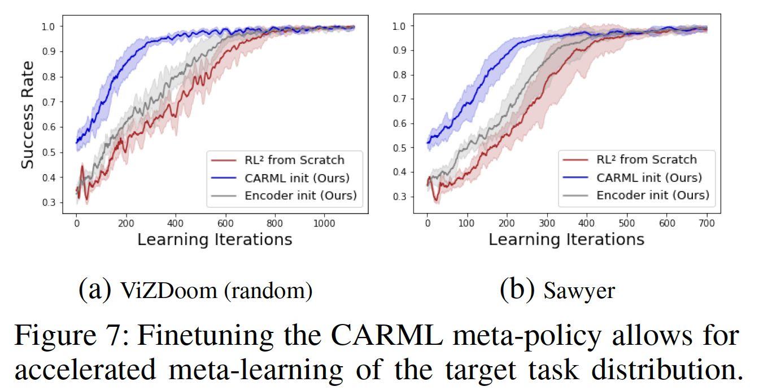
Transfer as Parameter Initialization

Slide 29
Challenges
Trajectory-level representation learning

Slide 30
Inductive Biases
Pixels + convnets
Model trajectories with conditionally independent states

Slide 31
Existing
Intrinsic motivation for incentivizing state-space exploration
How to learn useful representations without supervision in visual environments
Learning contextual policies capable of conditioning skills on side information
Here: Generalization as learning how to adapt across task distribution
Exploration by adapting task distribution based on current ability.
Notes:
Task parametrization
Goals are not always the best way to parametrize task
In principle, can apply our method on any policy…
I.e. can bootstrap agnostic to existing skills:
States vs Trajectories

Slide 32
Continually accumulate skills while exploring in a manner driven by current ability
Zone of Proximal Development (
Wake Sleep

Slide 33
Is it realistic to learn without supervision?
NFL: Can dynamics in environment lead us to free snacks?
Are environments naturally organizable or compressable?
Does vision play a key role here?
Supervision is a dirty word around here, but how much is ok?
How far does baking in more inductive biases (i.e. objects, relations, etc) go?

